Slide 1
Intelligent Sensing and Monitoring using Raspberry Pi and MQTT
GitHub Repository Link: https://github.com/mariammmramy/SIC_Team5_Monitoring

Slide 2
TABLE OF CONTENTS
01
02
03
PROBLEM
CONCEPT
COMPONENTS
04
TEAM MEMBERS

Slide 3
01
PROBLEM

Slide 4
Problems:
Safety and security risks, for example smoke, intruders and unknown events.
Lack of low-cost, real-time monitoring systems that can integrate multiple sensors.
Need for an automated system that can detect, alert, and report events remotely.

Slide 5
MONITORING SYSTEM
This project is a Raspberry Pi 4–based IoT monitoring system that uses sensors such as a microphone, ultrasonic sensor, DHT11, smoke sensor, and a camera. The data is processed on the Pi and sent to an IoT platform via MQTT for real-time monitoring. The system provides environmental sensing, object detection, and security alerts using LEDs and a buzzer.

Slide 6
03
COMPONENTS

Slide 7
SENSORS
DHT11
Smoke Sensor
Microphone
IR Module
Camera
ACTUATORS
3 LEDS
Buzzer

Slide 8
04
APPLICATION

Slide 9
Features
Environmental monitoring: Temperature, humidity, smoke detection.
Security monitoring: Object detection (ultrasonic), sound events, camera snapshots.
User alerts: LEDs + buzzer for immediate feedback.
Remote access: Real-time dashboard on IoT platform Blynk

Slide 10
05
Project Demo

Slide 11
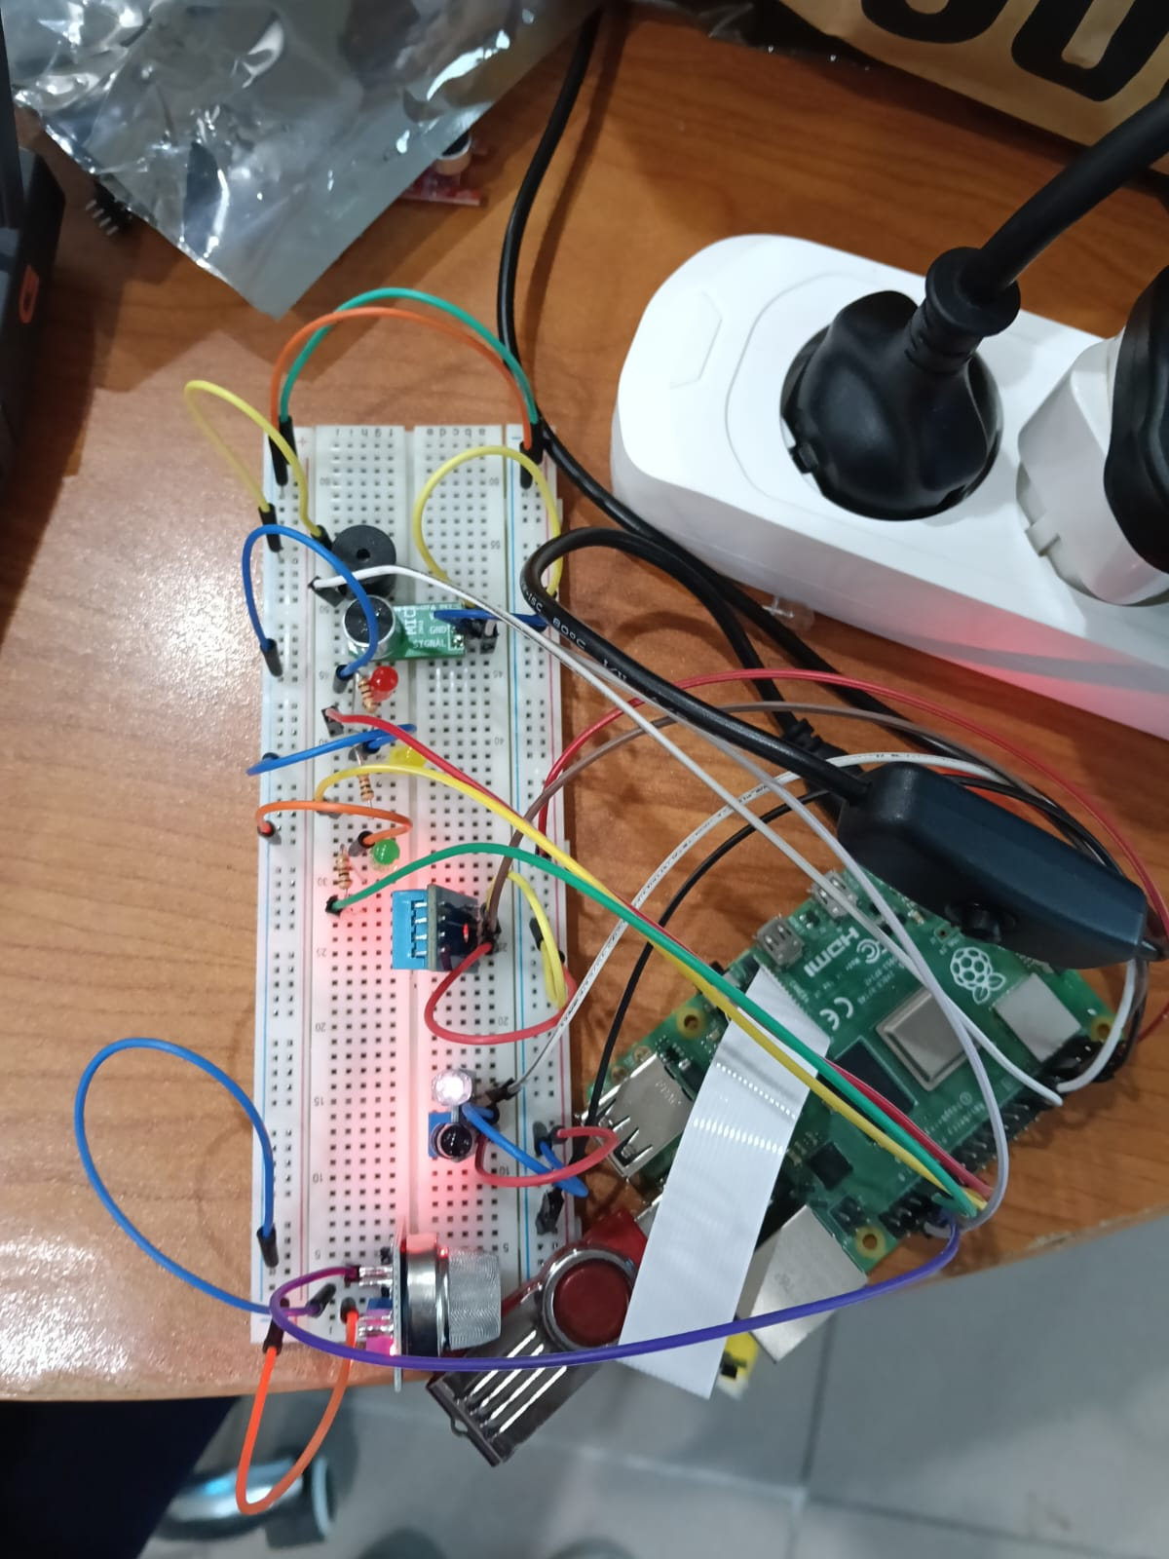
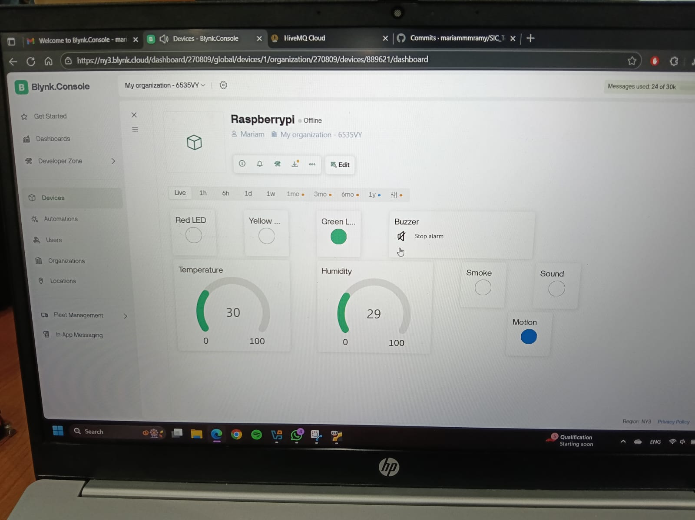

Slide 12
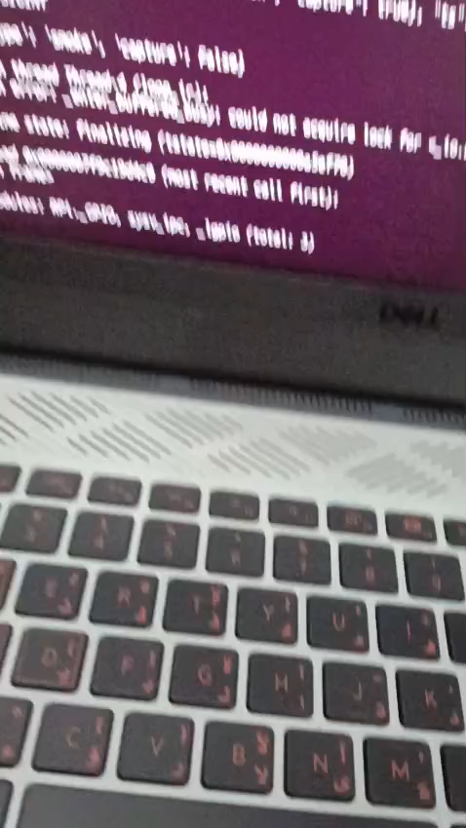

Slide 13
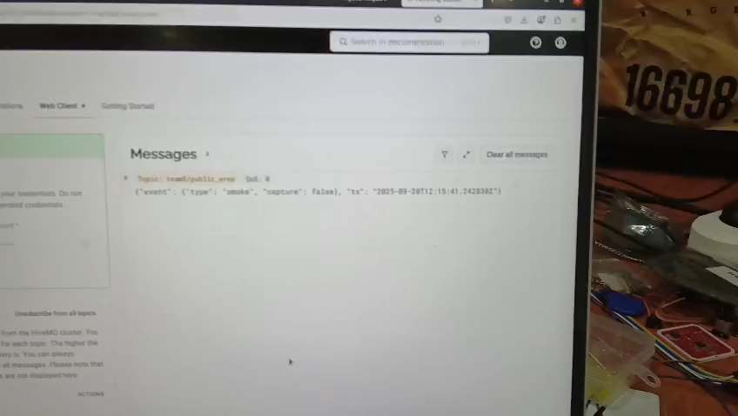

Slide 14
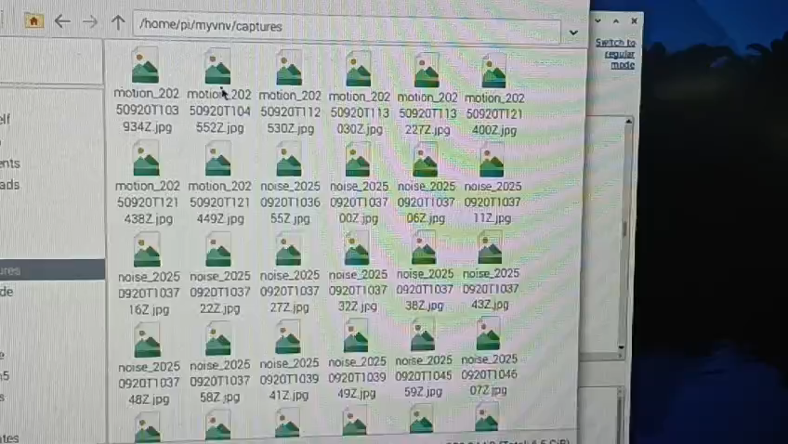

Slide 15
TEAMWORK
Basant
Nada
Mariam
-Hardware connections
-Blynk
-Sensor Integration
-MQTT
-Git and Github
-Sensor Integration
-Git and Github
-Powerpoint

Slide 16
THANK YOU!

